Slide 1
24-SEP-2008
03 Linear Lists
WU Wen
FIT, MUST

Slide 2
Outline
Introduction
What is the linear lists?
The concept of Abstract Data Type (ADT)
The linear list ADT
must-fit-lp002/C/08

Slide 3
Introduction (1)
Example: A grading record of LP002
(“student-1”, 85)
(“student-2”, 78)
…
(“student-N”, 90)
Representation: Array “a”
  The type of items (elements): e.g. int, to be simple.
  The memory space to hold the record: an array of ints.
  The size of the array: pre-defined and should be large enough.
  #define MAXSIZE 1024;
  int a[MAXSIZE];
The length of the record, or the number of items in the record: initially 0.
  int a_len = 0;
must-fit-lp002/C/08

Slide 4
Introduction (2)
Operation 1: adding an item to the end
supposing the record a has a_len items
  Steps:
  Check if the array space is large enough.
  Assign the item to a[a_len].
    Array indices are always starting from 0.
  Increment the length of the list.
    a_len = a_len+1.
must-fit-lp002/C/08

Slide 5
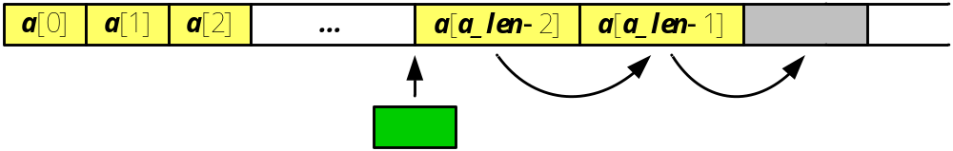
Introduction (3)
Operation 2: inserting an item in between
To insert an item at position i
  Steps:
  Check if the array space is large enough.
  Check if i is in range: 0 ≤ i ≤ a_len. (Why a_len?)
  Shift the items (starting from the insertion point) one position to the right. (How?)
  Assign the item to a[i].
  Increment the length: ++a_len.
…
must-fit-lp002/C/08

Slide 6
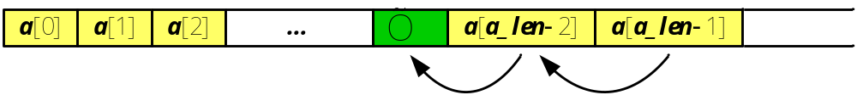
Introduction (4)
Operation 3: removing an item
To remove an item at position i
  Steps:
  Check if i is in range: 0 ≤ i < a_len. (What if the collection is empty?)
  Shift the items (next to the deleted point) one position to the left. (How?)
  Decrease the length: --a_len.
must-fit-lp002/C/08

Slide 7
Linear Lists (1)
Linear: the sequential property
  The unique “the first element” which has no predecessor: Head
  The unique “the last element” which has no successor: Tail
  All other elements have the unique predecessor and successor
  We can be more concrete to say that in a linear list, each element has its definite position. If the list is modified, some elements’ positions may be changed.
must-fit-lp002/C/08

Slide 8
Linear Lists (2)
Linear: representation. The array can be the representation of a linear list.
  It has finite number of elements (items). It has a length property.
  It forms a sequence, where items are arranged one by one. This “one next to another” relation is called linear relation property.
must-fit-lp002/C/08

Slide 9
Linear List Operations
Initialize a linear list to an empty list.
Retrieve the length property.
Retrieve an item at position i.
Insert an item at position i.
Remove an item at position i.
And, given the item’s value, locate an item’s position.
We call a list with length 0 the empty list.
For example: The List is 12, 15, 98, 33, 76.
Length(List); Retrieve(1); Insert(60, 3); Find(15)
must-fit-lp002/C/08

Slide 10
Abstract Data Type (ADT)
Data type
Abstract data type
Data type
  Integer, real, boolean
Operations over them
  +,-,x,/
Abstract data type
  List, queue, set, graphs
Operations over them
  Set: union, intersection
  List: insert, remove
must-fit-lp002/C/08

Slide 11
Abstract Data Type (ADT)
Definition:
  ADT is a specification of a set of data and the set of operations that operate on the data.
  From Book <Data structures a pseudocode approach with c> (pp. 12).
By “abstract”, we means:
  We know what a data type can do
    With an ADT users are not concerned with how the task is done but rather with what it can do. In other words, the ADT consists of a set of definitions that allow programmers to use the functions while hiding the implementation. This generalization of operations with unspecified implementations is known as abstraction. We abstract the essence of the process and leave the implementation details hidden.
  How it is done is hidden from the user (encapsulation)
must-fit-lp002/C/08

Slide 12
Abstract Data Type (ADT)
ADT separates the interface and implementation
  Interface (.h file) : declaration of data and operations
    what a data type can do
  Implementation (.c file): implementation of operations
    How it is done, which is hidden from the user
    the user use the ADT only through the interface
Basic ideas behind ADT:
  The implementation is written once and used by many programmers
  Keep interface unchanged while implementation changes
must-fit-lp002/C/08

Slide 13
Linear List ADT- Declaration
  struct _T_linear_list {int a[MAXSIZE]; int a_len;};
typedef struct _T_linear_list linear_list_t;
typedef enum _T_error_t
{NOERROR, OVERFLOW, SUBSCRIPT}
error_t;
typedef int elem_t;
/* create and destroy the linear list */
linear_list_t *Create(void);
void Destroy(linear_list_t *L);
/* A set of operations */
void Set_null(linear_list_t *L); /* empty list*/
int Length(linear_list_t *L); /* length of the list */
elem_t Get(linear_list_t *L, int i); /* get the value */
error_t Insert(linear_list_t *L, elem_t x, int i); /* insert */
error_t Remove(linear_list_t *L, int i); /* remove */
int Locate(linear_list_t *L, elem_t x);/* locate the pos.*/
must-fit-lp002/C/08

Slide 14
Linear List ADT- Encapsulation(1/4)
/* create and destroy the linear list */
linear_list_t *Create(void);
void Destroy(linear_list_t *L);
Implementation detail to create (initialize) and destroy a list
  Use malloc(sizeof(linear_list_t)) to allocate space.
  Use free(L) to free space.
  Don’t forget to initialize certain fields.
For user: using only references (pointers) to access the ADT, without knowing any detail.
must-fit-lp002/C/08

Slide 15
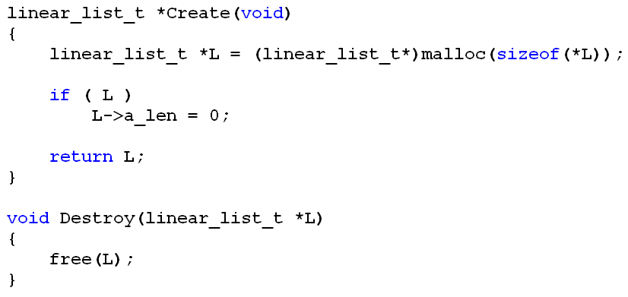
Linear List ADT- Encapsulation(2/4)
sizeof(linear_list_t)
must-fit-lp002/C/08

Slide 16
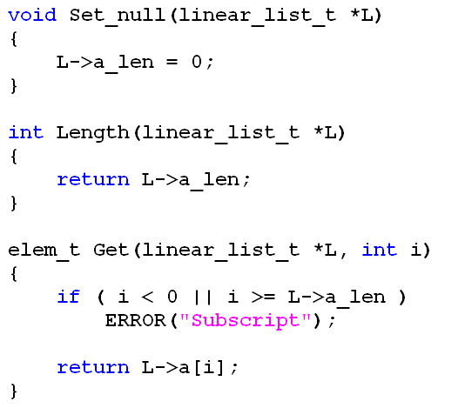
Linear List ADT- Encapsulation(3/4)
/* empty list*/
/* the length of the list*/
/* get the value at position i*/
must-fit-lp002/C/08

Slide 17
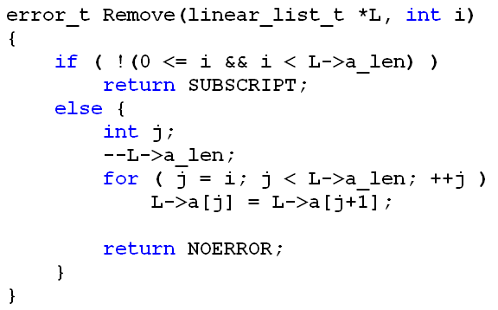
Linear List ADT- Encapsulation(4/4)
/* remove the item at index i*/
/* whether 0<= i < L->a_len*/
/* decrease the length L->a_len*/
i
--(L->a_len)
L->a[j]=L->a[j+1]
must-fit-lp002/C/08
Notes:
Zero ['ziərəu, 'zirəu]

Slide 18
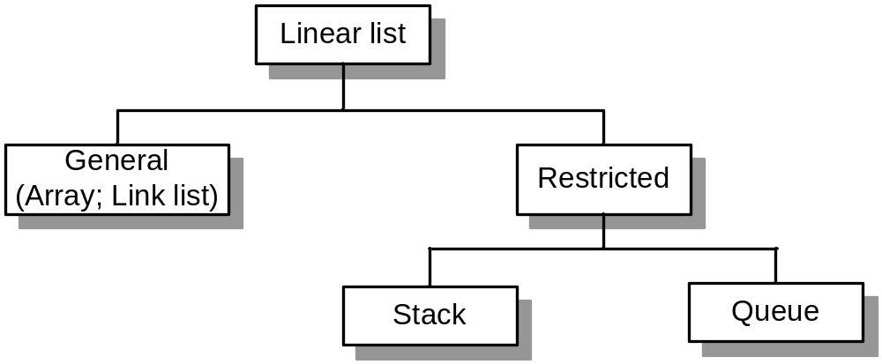
Linear List Categories
How do we classify a data structure?
  The properties.
  The operations.
The linear list can be classified into two categories
must-fit-lp002/C/08

Slide 19
Linear List Categories
Two categories
  General list: element can be inserted or deleted anywhere in the list
  Restricted list: addition and deletion of elements are restricted to the ends of the list.
    Stack: the last in-first out (LIFO) list
    Queue: the first in –first out (FIFO) list
must-fit-lp002/C/08

Slide 20
Class Exercise: RemoveDup
Understand the array list implementation (larray.h/c) on ftp:
  See: ~\Proj_example\Proj_Larray
Add one operation, RemoveDup(), to larray.h/c:
  RemoveDup () will delete all duplicates and return the numbers of deleted items
  RemoveDup () should have the prototype below:
  int RemoveDup (int x,LIST L);
must-fit-lp002/C/08

Slide 21
Class Exercise: Encapsulation
Question: What happens if we make two modifications below:
  In larray.c, add “complete declaration of struct list”
  In larray.h, replace “complete declaration of struct list” by “incomplete declaration of struct list”
  Please modify codes to fix this problem.
  struct list; // incomplete declaration of struct list
        struct list //complete declaration of struct list
        {
        int capacity;
        int size;
        int *array;
        };
must-fit-lp002/C/08

Slide 22
Class Exercise: Encapsulation
Question: how to declare two different structure types in which each contain a pointer to the other.
Solution:
    struct B; // incomplete declaration of struct B
    struct A {// complete declaration of struct A
    struct B *partner;
    /*other declarations;*/
    }
    struct B {// complete declaration of struct B
    struct A *partner;
    /*other declarations;*/
    }
must-fit-lp002/C/08

